Slide 1

“Loan Default Prediction”
Atharv Tayal
Aviral Dixit
Ayush Goyal
Dhairya Goel
Mr. Shivansh Prasad

Slide 2


Loan Default Prediction: A Classification Approach
Predicting loan defaults is crucial for lenders. This project uses machine learning to enhance the loan approval process. We aim to identify risk early.
by dhruv goel

Slide 3

The Problem: Loan Default Risk
$140B
30%
Annual Losses
Risk Reduction
Loan defaults cost lenders billions every year.
Accurate predictions can significantly reduce these losses.
15%
Fair Access
Improved models lead to fairer credit access for borrowers.
Predicting defaults helps manage risk and refine pricing strategies. This ultimately benefits both lenders and applicants.

Slide 4




Methodology: Classification Algorithms
Logistic Regression
A statistical model for binary outcomes.
Decision Trees
Flowchart-like structures for decision making.
Random Forest
An ensemble method for improved accuracy.
We utilized Logistic Regression, Decision Trees, and Random Forest. Data was split 80/20 for training/testing. Performance was measured by accuracy, precision, recall, and F1-score with 5-fold cross-validation.

Slide 5

Data Preprocessing and Feature Engineering
Missing Values
Imputed using mean or median strategies.
Categorical Encoding
One-hot encoding for nominal variables.
Feature Scaling
StandardScaler applied for normalization.
Feature Selection
Leveraged domain knowledge for key inputs.
We prepared the dataset by handling missing values and transforming variables. This crucial step ensures data quality and model effectiveness.

Slide 6
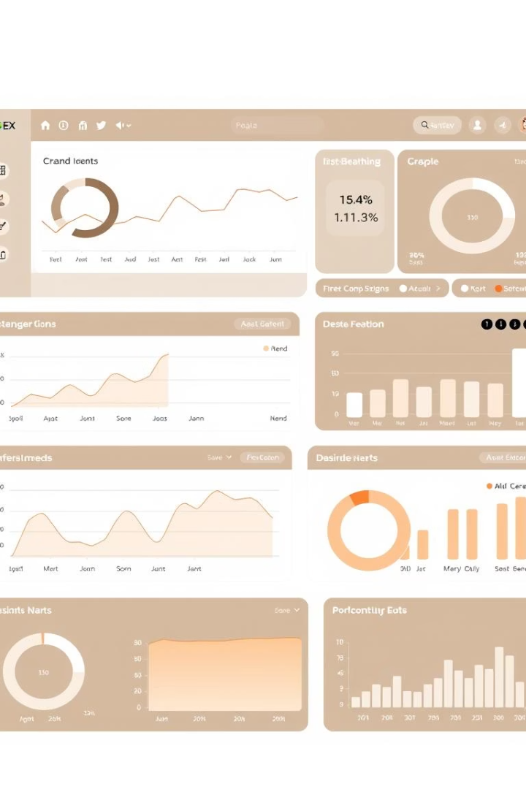
Results: Model Performance
Model
Accuracy
F1-Score
Logistic Regression
80%
75%
Decision Trees
72%
68%
Random Forest
83%
80%
Random Forest demonstrated the best performance among all models. It achieved the highest accuracy and F1-score, proving its robustness.

Slide 7




Feature Importance: Random Forest
Credit History
Income
Contributed 35% to prediction accuracy.
Accounted for 25% of feature importance.
Loan Amount
Weighted at 15% in the model.
Credit History, Income, and Loan Amount are the most influential features. These insights are crucial for understanding loan risk factors.

Slide 8
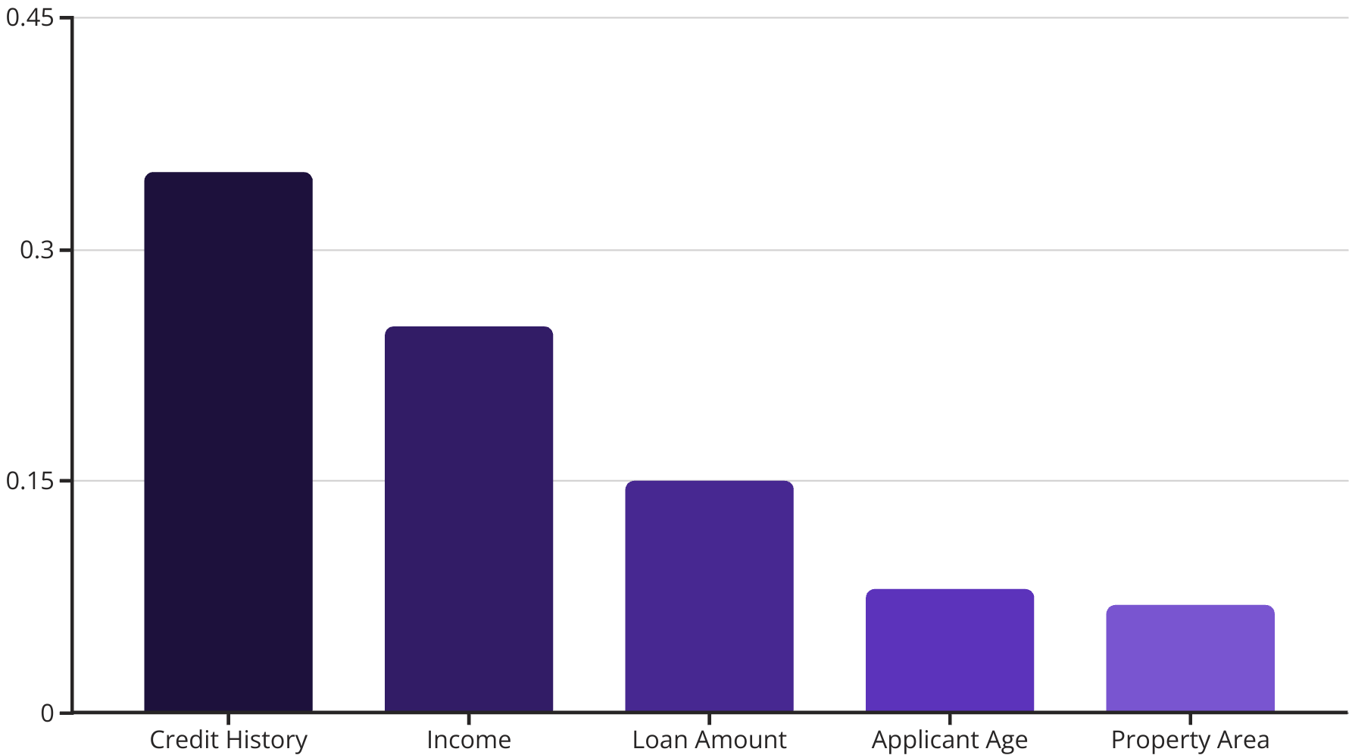
Visualizing Feature Importance
The bar chart clearly shows Credit History as the dominant feature. Loan Amount and Income are also significant contributors to the prediction model.

Slide 9
Conclusion and Future Work
Key Takeaways
Next Steps
Random Forest excels in predictive performance. Feature importance guides understanding.
Hyperparameter tuning can optimize models further. More data will improve accuracy.
These models enable more informed lending decisions. They contribute to a more robust financial system.

Slide 10
Thank You

